Slide 1
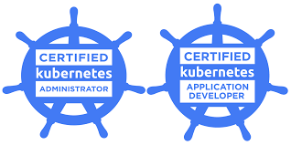
Who am I ?
11 years of comprehensive experience in the areas of Docker, Kubernetes ,Cloud (AWS & Azure), automation with Ansible , ELK Stack (Elasticsearch, Logstash, Kibana), Grafana, Cloud Watch, Prometheus , Splunk.
Certifications
Agile - Certified Scrum Master (CSM) – Certification ID : 000832020
Certified Kubernetes Administrator - CKA-1900-003992-0100
Certified Kubernetes Application Developer (CKAD)- CKAD-2000-003341-0100
Red Hat Certified Specialist in Ansible Automation Certification ID: 170-006-431
Red Hat Certified Engineer in (RHEL) 7.0 Certification ID: 170-006-431
Red Hat Certified System Administrator Certification ID: 170-006-431
AWS Certified Solutions Architect– Professional (SAP) Validation Number YKS7E5FCKE44Q09T
AWS Certified Solutions Architect - Associate (SAA) Validation Number MCRKHLEKCBB4QY9P
AWS Certified Developer - Associate (DVA) Validation Number C0RGWMFCC2QQ1J3V
1Z0-851Java Standard Edition 6 Programmer Certified Professional

Slide 2
Kubernetes

Slide 3
Course Content
Module 1: Kubernetes Concepts
Labs
Module 2: Installation, Configuration,Validation & Cluster Maintenance
Labs
Module 3: Application LifeCycle Management
Labs
Module 4: Scheduling
Labs
Module 5: Networking
Labs
Module 6: Storage
Labs
Module 7: Security
Labs
Module 8: Logging and Monitoring
Labs
Module 9: Troubleshooting
Labs

Slide 4
Introducing Kubernetes
Automate container deployment,scaling & management

Slide 5
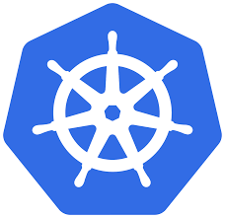
What this session cover ?
This session aimed at individual who have Zero knowledge of Kubernetes and would like to gain real time of experience of Kubernetes.

Slide 6
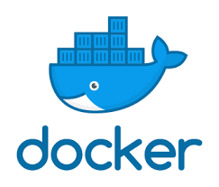
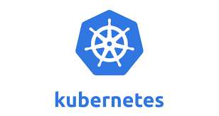
Prerequisite for k8s
Although i will start this Kubernetes session from scratch , a prior Docker knowledge is required.
Docker Certified Associate (DCA)
Certified Kubernetes Administrator (CKA)
This certification is scenario based exam not multi choice questions, so if you are appearing for exam then Practice is very very important.

Slide 7
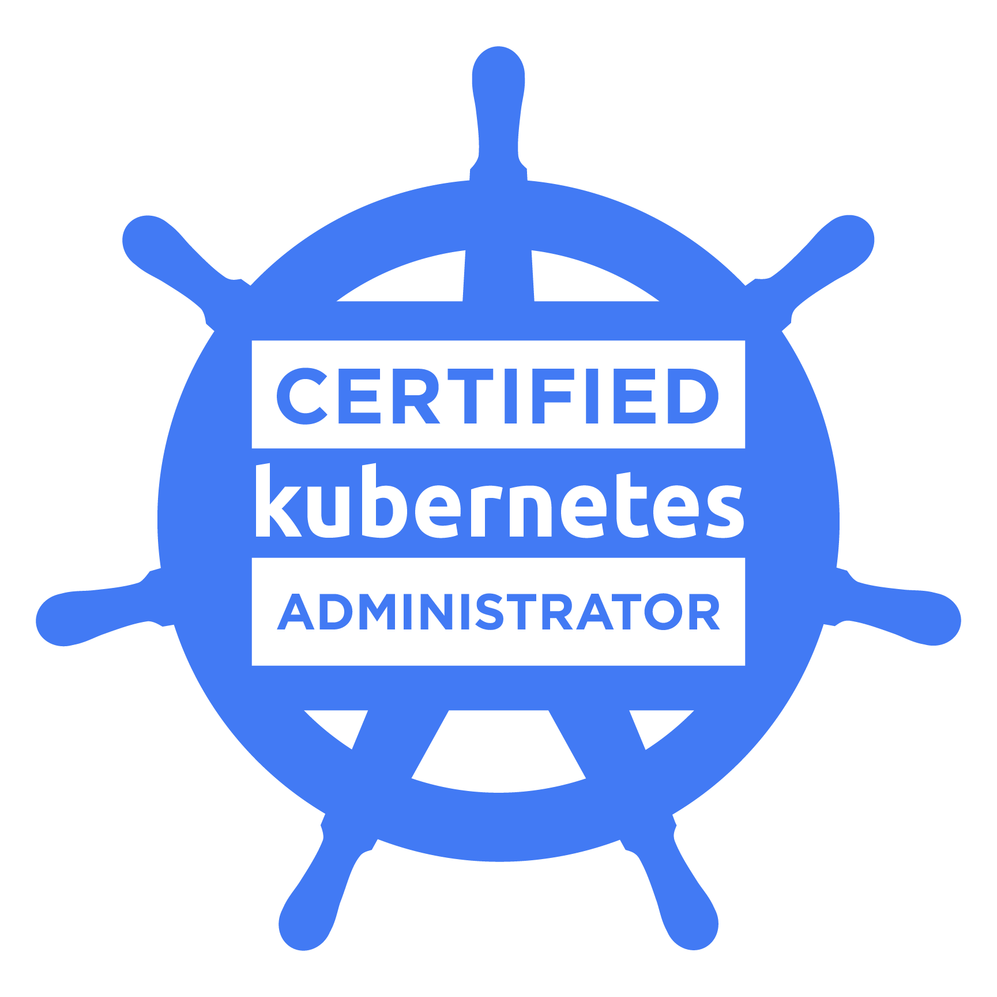
CKA exam details
The Certification focuses on the skills required to be a successful Kubernetes Administrator in industry today. This includes these general domains and their weights on the exam:
Application Lifecycle Management 8%
Installation, Configuration & Validation 12%
Core Concepts 19%
Networking 11%
Scheduling 5%
Security 12%
Cluster Maintenance 11%
Logging / Monitoring 5%
Storage 7%
Troubleshooting 10%
https://www.cncf.io/certification/cka/
https://github.com/cncf/curriculum/blob/master/CKA_Curriculum_V1.18.pdf
https://training.linuxfoundation.org/wp-content/uploads/2020/04/CKA-CKAD-Candidate-Handbook-v1.10.pdf

Slide 8
My Lab Codes
My workspace:
https://github.com/shivamjhalabfiles/kubernetes-lab

Slide 9
Kubernetes Introduction

Slide 10
Introducing Kubernetes
Automate container deployment,scaling & management

Slide 11
Getting Started
The word Kubernetes is Greek for pilot or helmsman, the person who steers the ship - the person standing at the helm (the ship’s wheel). This theme is reflected in the logo.
It’s also referred to as Kube or K8s, pronounced Kates, where the 8 signifies the number of letters omitted between the first and last letter.
Kubernetes is a software system for automating the deployment and management of complex, large-scale application systems.
Kubernetes logo

Slide 12
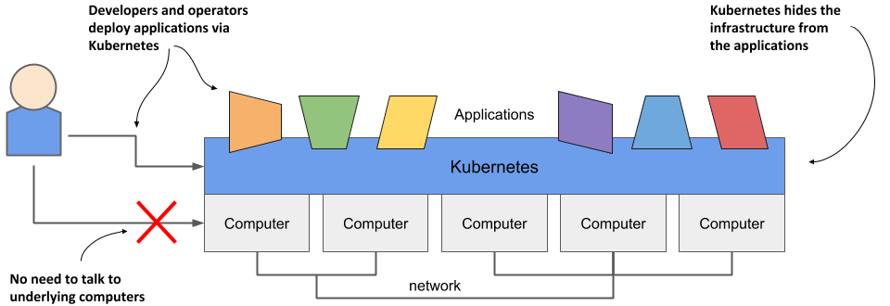
What it does ?

Slide 13
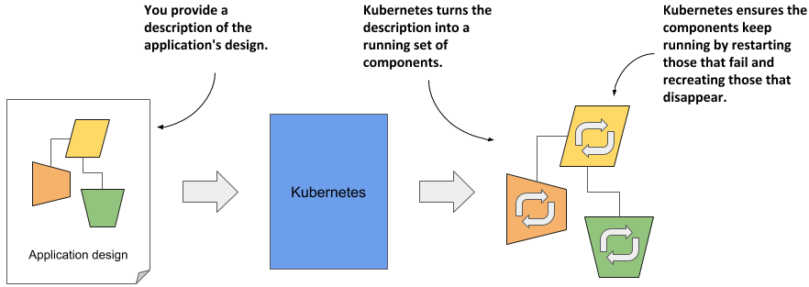
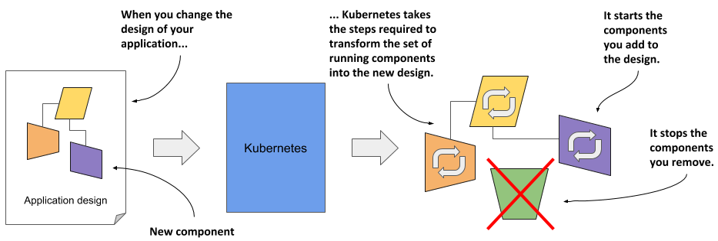
How it does ?
Declarative way of application deployment

Slide 14
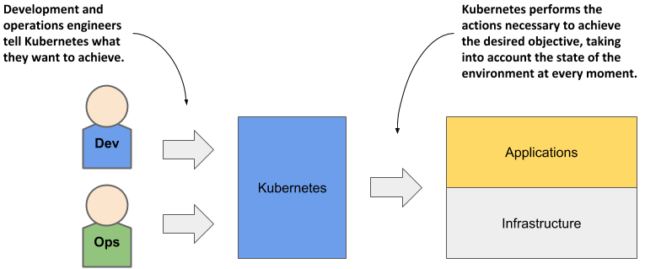
What is role of Dev & Ops Engineer?

Slide 15
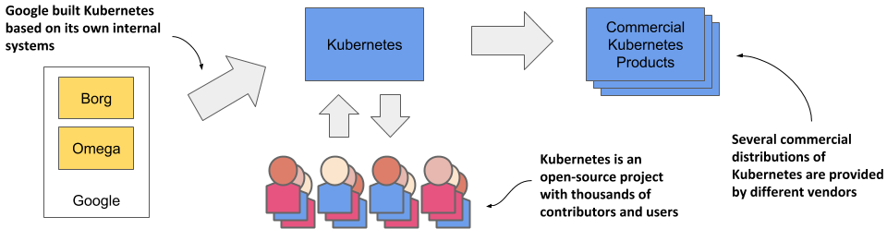
How it Originated ?
Kubernetes was originally developed by Google.
Kubernetes is not an open-sourced version of Borg or Omega. It’s more like Kubernetes shares its DNA and family history with Borg and Omega.
Kubernetes is an open-source project donated to the CNCF in 2014, it’s licensed under the Apache 2.0 license, version 1.0 shipped way back in July 2015

Slide 16
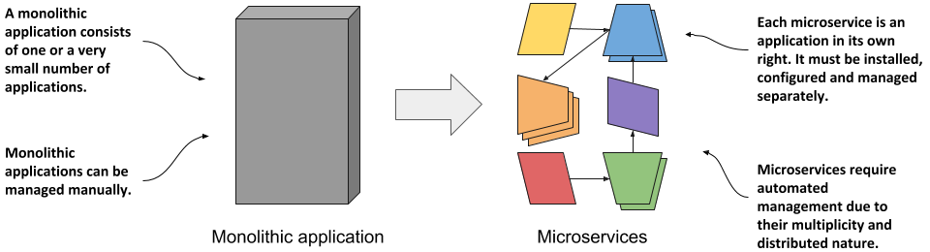
Why K8s is popular ?
Horizontally scaling the monolithic application was rarely possible
Kubernetes automate the management of Microservices , the features it offers make the task of managing hundreds of microservices are very small
Bridging the Dev and Ops conflict

Slide 17
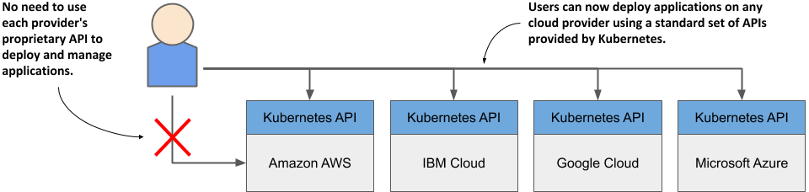
Managed Kubernetes
Managed Kubernetes is when third-party providers take over responsibility for some or all of the work necessary for the successful set-up and operation of K8s.
With managed Kubernetes, get easy access to a Kubernetes cluster without having to set up and maintain it themselves.

Slide 18


Slide 19
Understanding Kubernetes
Automate container deployment,scaling & management

Slide 20
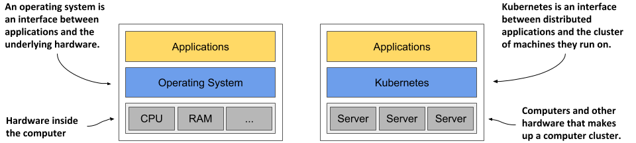
What exactly Kubernetes looks like ?
Kubernetes is like an Operating System for computer clusters
Just as an operating system supports the basic functions of a computer, like scheduling processes on its CPUs and acting as an interface between the application and the computer’s hardware
Kubernetes schedules the components of a distributed application onto individual computers in the computer cluster and acts as an interface between the application and the cluster.

Slide 21
What Kubernetes do ?
service discovery - a mechanism that allows applications to find other applications and use the services they provide
horizontal scaling - replicating your application to adjust to fluctuations in load
load-balancing - distributing load across all the application replicas
self-healing - keeping the system healthy by automatically restarting failed applications and moving them to healthy nodes after their nodes fail
leader election - a mechanism that decides which instance of the application should be active while the others remain idle but ready to take over if the active instance fails.

Slide 22
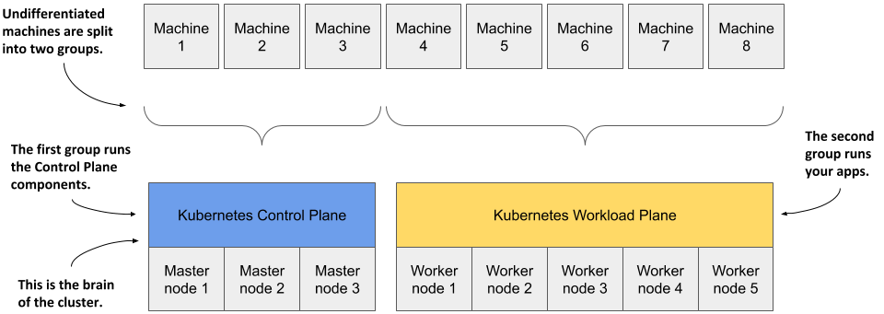
How K8s deployed on cluster of computer ?
Kubernetes Cluster is divided into two groups - the master and the worker nodes.
The master node will run the Kubernetes Control Plane
Applications- your workloads run on worker nodes.

Slide 23
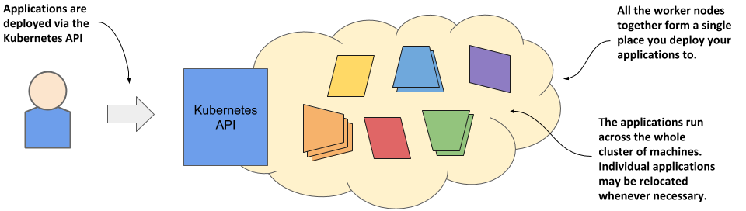
Where your application is deployed ?
When you deploy applications, Kubernetes decide which worker node application should be deployed .
Kubernetes may later even move the application from one node to another. You may not even notice when that happens, and you shouldn’t care.

Slide 24
Benefits of Kubernetes
Self-Service deployment of Applications
Reducing costs via better infrastructure utilization
Automatically adjusting to changing load
Keep application running smoothly
Simplifying application development

Slide 25


Slide 26
Kubernetes Architecture
Automate container deployment,scaling & management

Slide 27
Getting Started
A Kubernetes cluster consists of nodes divided into two groups
A set of master nodes that host the Control Plane components, which are the brains of the system, since they control the entire cluster.
A set of worker nodes that form the Workload Plane, which is where your workloads (or applications) run.

Slide 28
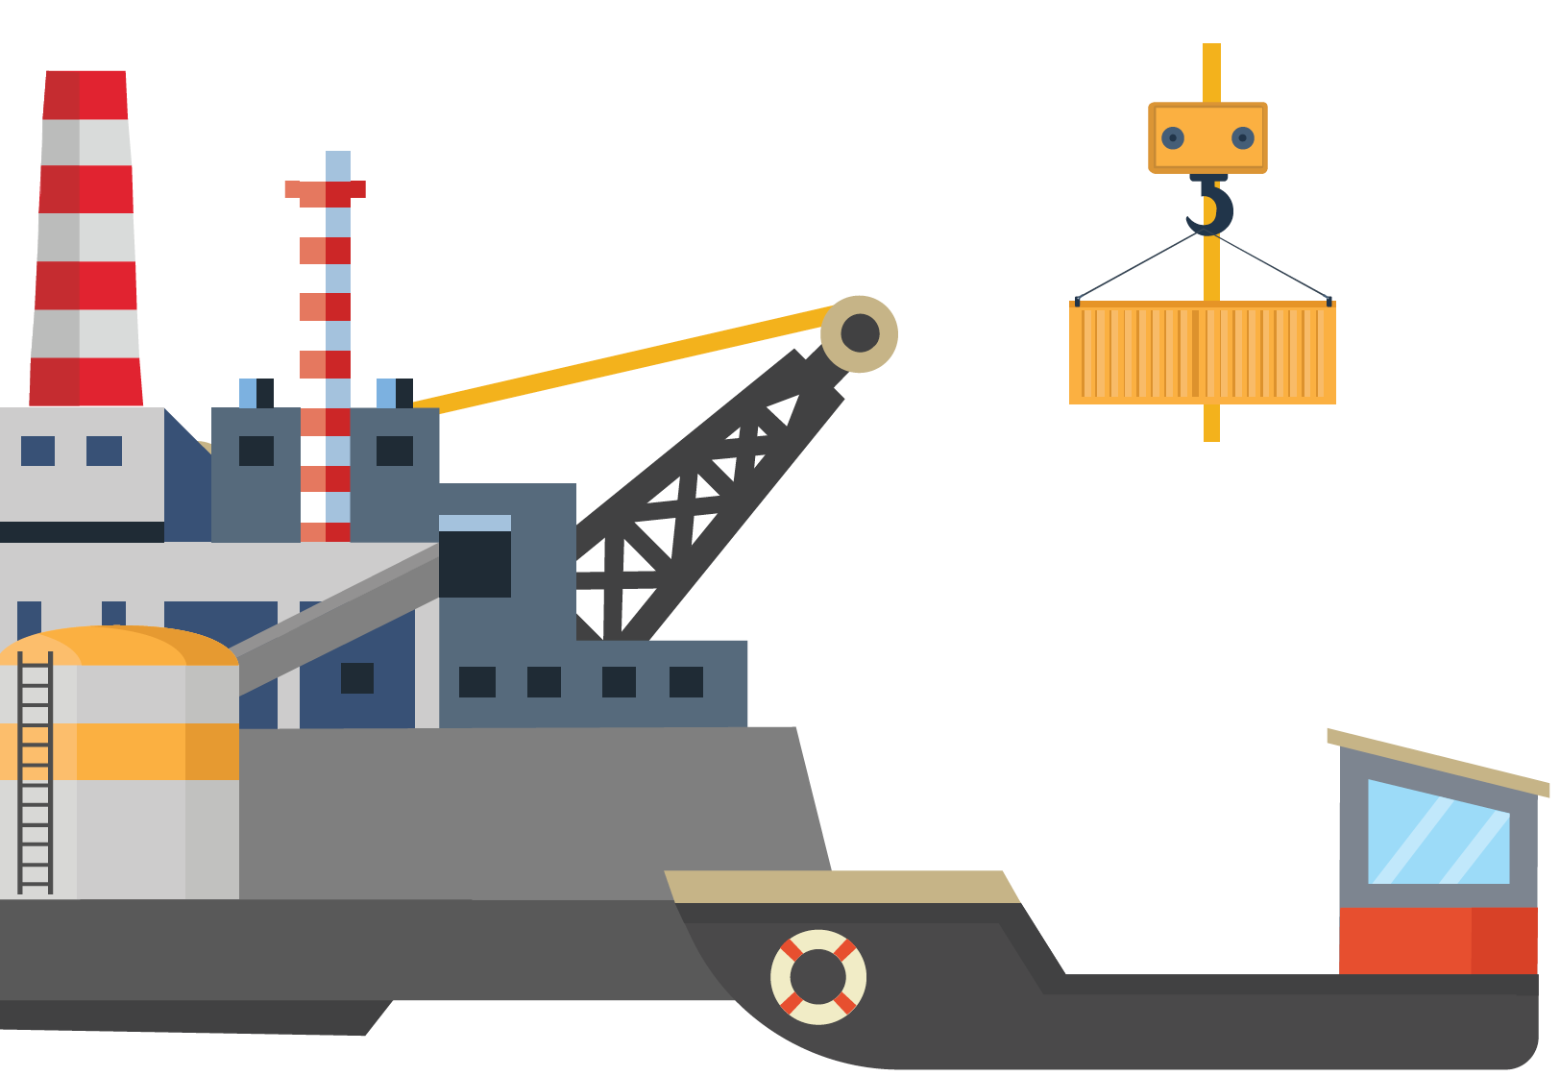
Ship analogy
Control Ship
Managing & Monitoring of the cargo ships
Manage, Plan, Schedule, Monitor - Master node
Cargo Ship
Carries containers across the sea
Host Application as Containers ~ Worker Nodes

Slide 29
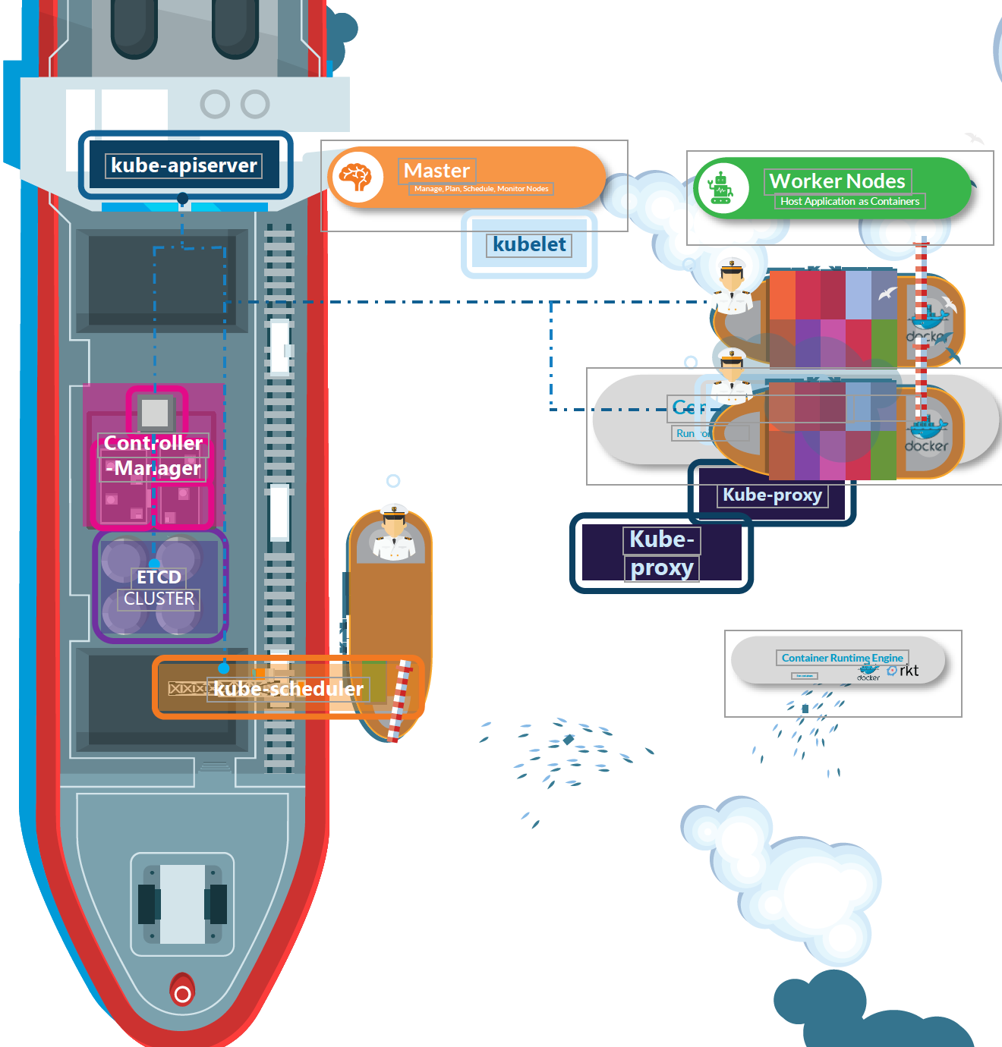
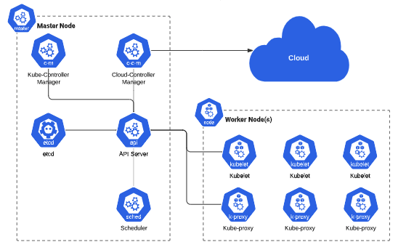
Analogy of Ship with Kubernetes

Slide 30
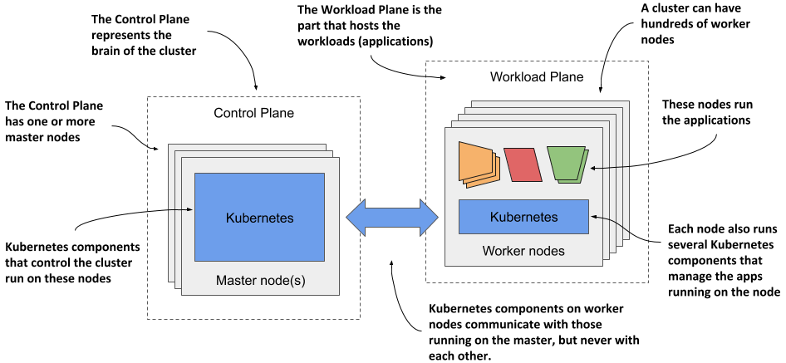
K8s Architecture

Slide 31
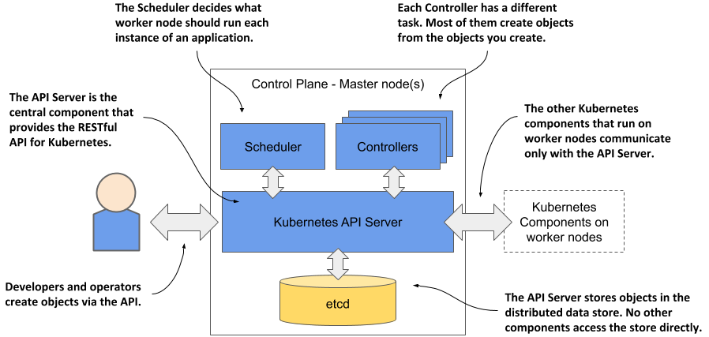
Master (Control Plane) Components
Control Plane Componentes
Kube API server
The cluster store ( etcd)
Kube controller manager
Kube scheduler
The cloud controller manager
Notes:
The components of the Control Plane hold and control the state of the cluster, but they don’t run your applications. This is done by the (worker) nodes.

Slide 32
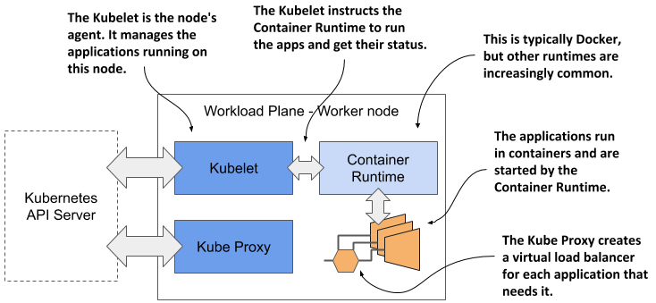
Worker Node Components
Worker Node Componentes
Kubelet
Container Runtime
Kube Proxy
Notes:
Each node runs the below components:
• The Kubelet, an agent that talks to the API server and manages the applications running on its node. It reports the status of these applications and the node via the API.
• The Container Runtime, which can be Docker or any other runtime compatible with Kubernetes. It runs your applications in containers as instructed by the Kubelet.
• The Kubernetes Service Proxy (Kube Proxy) load-balances network traffic between applications. Its name suggests that this traffic flows through it, but that’s no longer the case.

Slide 33
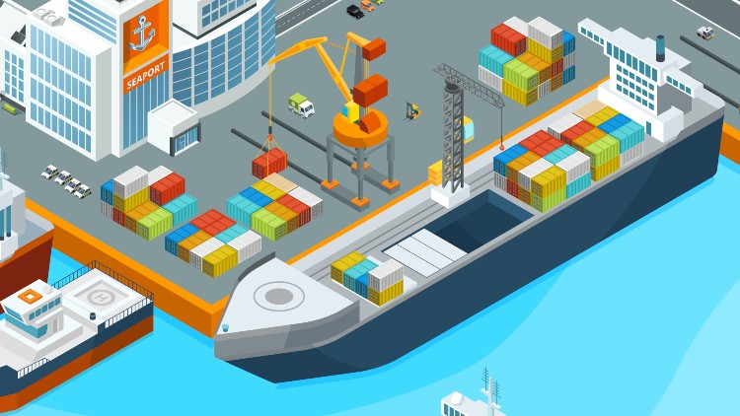
Ship Cranes ( Kube-Scheduler )
Identifies the placement of containers
Identifies the right node to place a containers

Slide 34

Cargo Ship Profiles( ETCD Cluster )
HA database ~ Which containers on which ships? When was it loaded?
HA database ~ Which containers on which ships? When was it loaded?

Slide 35
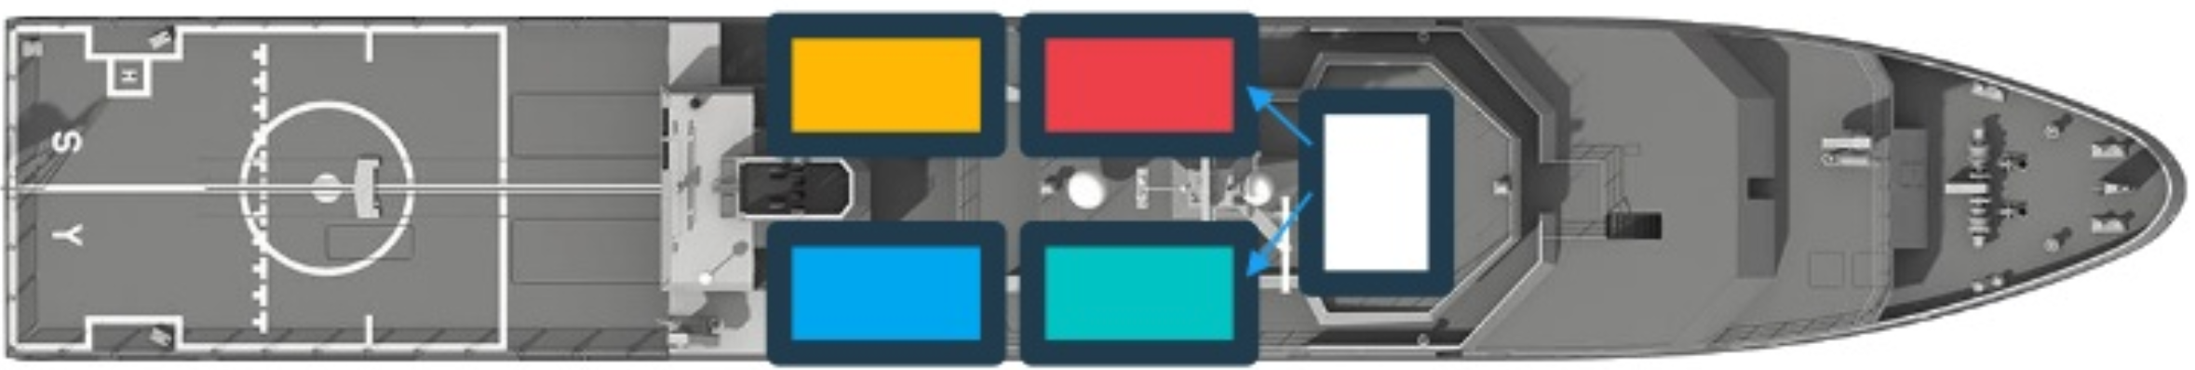
Offices in Dock ( Kube-Controller)
Operation Team Office ~ Ship Handling, Control
Cargo Team Office ~ verify if containers are damaged, ensure that new containers are rebuilt
IT & Communication Office – Communication in between various ships
Controllers - Node Controllers – Takes care of Nodes | Responsible for onboarding new nodes in a cluster | Availability of Nodes
Replicas Controller – Ensures that desired number of containers are running at all times
Controller Manager - Manages all these controllers in place

Slide 36
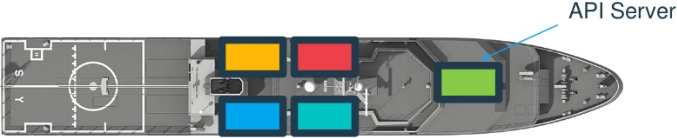
Communicator ( Kube API Server )
How does each of these service communicate with each other?
A primary management component of k8s
Responsible for orchestrating all operations within a cluster
Exposes K8s API ,used by external users to perform management operation in the cluster and number of controller to monitor the state of the cluster

Slide 37
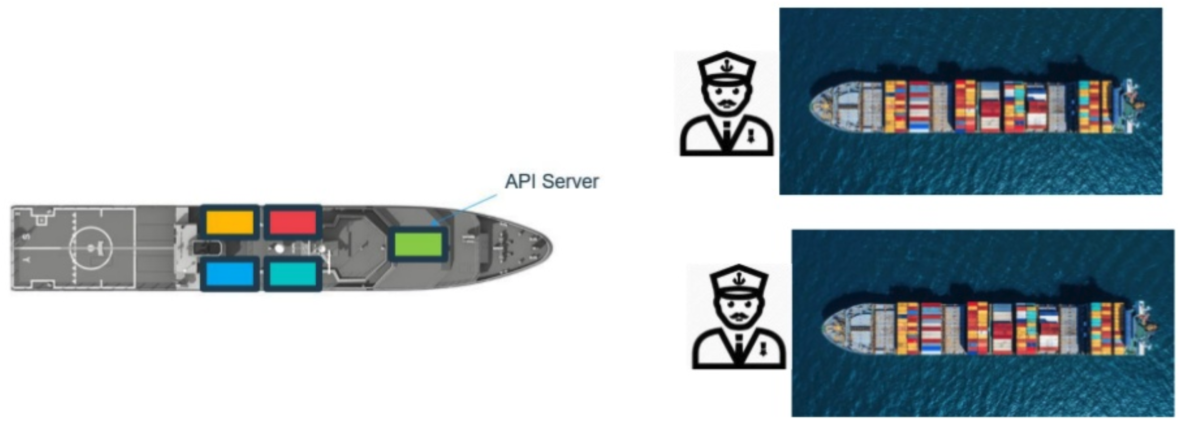
Captain of the Ship ( Kubelet )
Manages all sort of activity on the ship
Let master ship knows they are interested to join
Sending reports back to master about the status of the ship
Sending reports about the status of the containers
Agent which runs on each nodes of the container

Slide 38
Communication between Cargo Ships ( Kube-proxy)
How does two cargo ships communicate with each other?
How will web server running on one worker node reach out to DB server on another worker node?
Kube-proxy helps communication between worker nodes
Kube-proxy

Slide 39
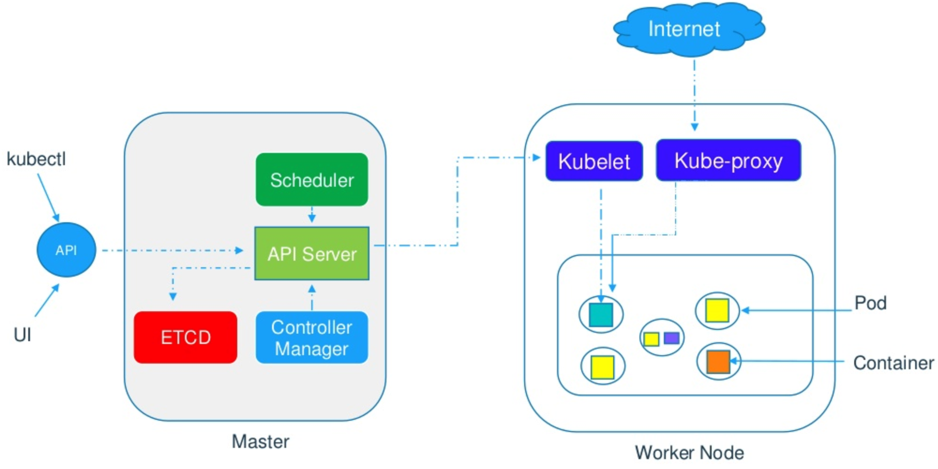
Overall Kubernetes Architecture

Slide 40
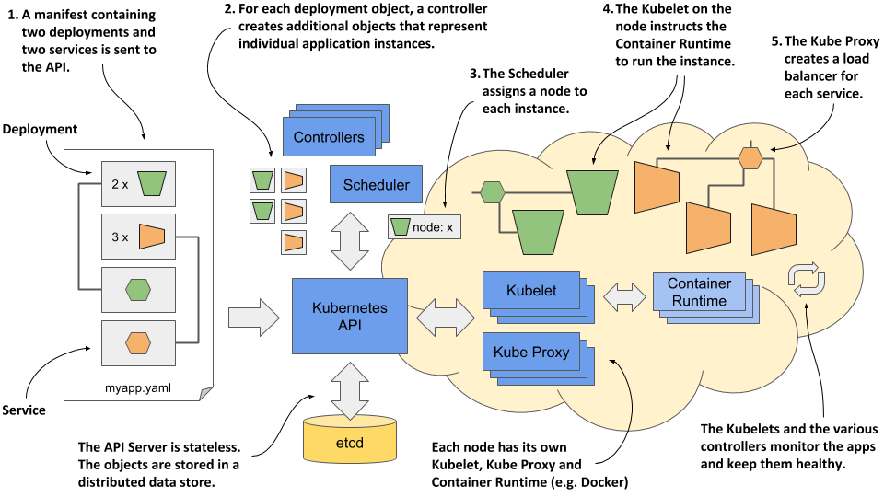
How to deploy an Application on K8s ?
Everything in Kubernetes is represented by an object. You create and retrieve these objects via the Kubernetes API
These objects are usually defined in one or more manifest files in either YAML or JSON format.
Notes:
These actions take place when you deploy the application:
1. You submit the application manifest to the Kubernetes API. The API Server writes the objects defined in the manifest to etcd.
2. A controller notices the newly created objects and creates new objects - one for each application instance.
3. The Scheduler assigns a node to each instance.
4. The Kubelet notices that an instance is assigned to the Kubelet’s node. It runs the application instance via the Container Runtime.
5. The Kube Proxy notices that the application instances are ready to accept connections from clients and configures a load balancer for them.
6. The Kubelets and the Controllers monitor the system and keep the applications running.

